Slide 1
Application of Multimedia Mnemonics in Elementary Geography Instruction
105th MSCSS Conference 2008, Wilmington DE
Shippensburg University
Han Liu, Ph.D.

Slide 2
Pennsylvania Geography in Numbers
1 | 2 | 3 | 4 | 5 | 6 | 7 | 8 | 9 | 10

Slide 3
1. One Capital City

Slide 4
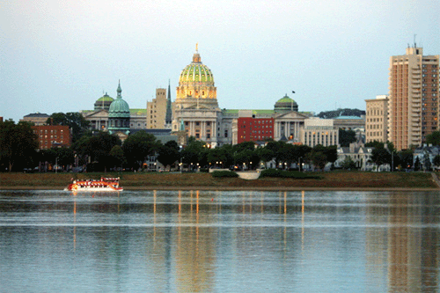
PA Capital City: Harrisburg

Slide 5
2. Two Big Cities

Slide 6
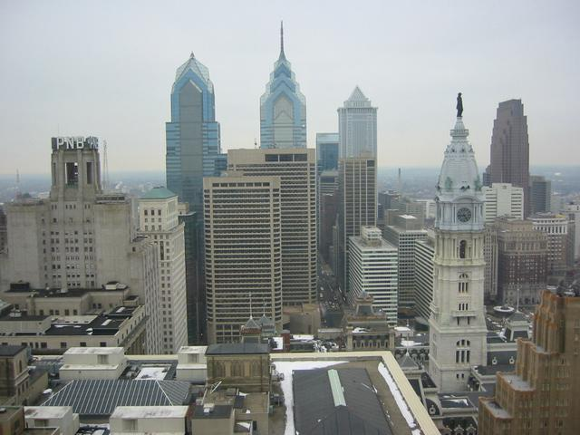
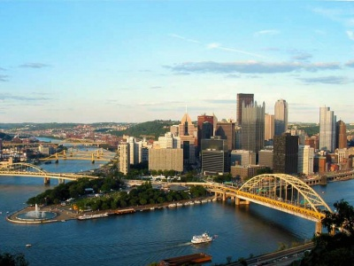
Philadelphia Pittsburgh

Slide 7
3. Three Major Rivers

Slide 8
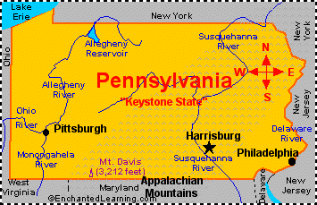
Ohio (Pittsburgh) Susquehanna River (Harrisburg) Delaware River (Philadelphia)

Slide 9
4. Four Mountains

Slide 10
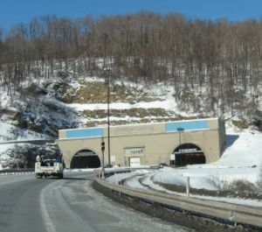
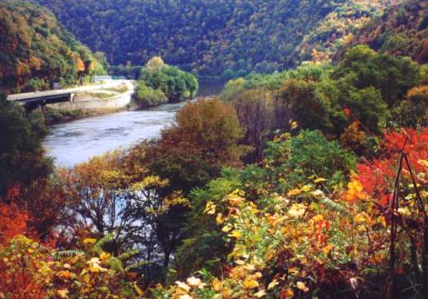
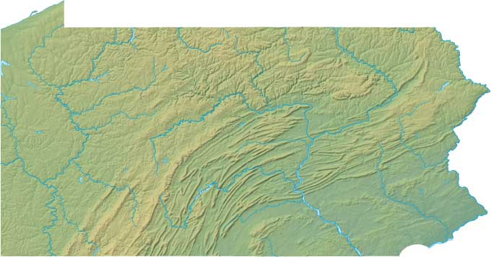
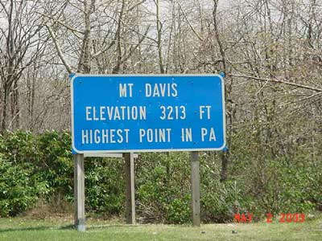
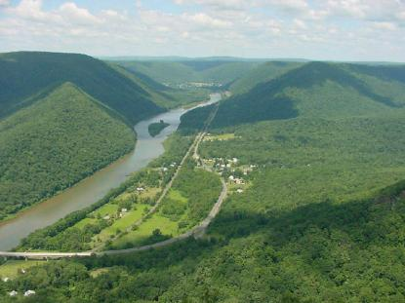
PAMA Alleghany Mountains Appalachians Mountains Pocono Mountains Mt. Davis
Pocono Mountains
Alleghany Mountains
Mt. Davis
Appalachian Mountains

Slide 11
5. Five Natural Regions

Slide 12
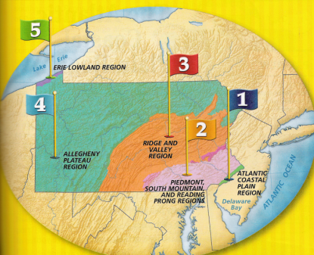
Mnemonics: Epara 1. Atlantic Coastal Plain 2. Piedmont 3. Ridge and Valley 4. Allegheny Plateau 5. Erie Lowland

Slide 13
6. Six Neighboring States

Slide 14
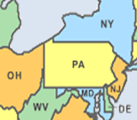
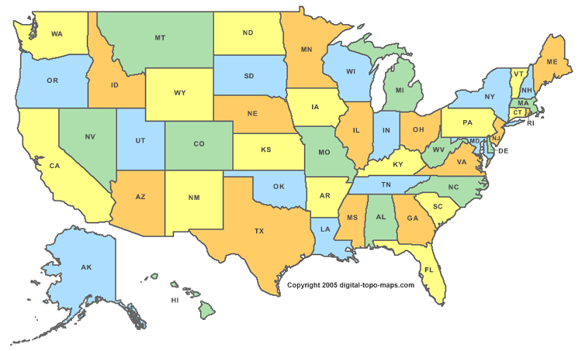
1. New York 2. New Jersey 3. Delaware 4. Maryland 5. West Virginia 6. Ohio

Slide 15
7. Seven Valleys

Slide 16
Susquehanna Valley Lehigh Valley Cumberland Valley Lackawanna Valley Lebanon Valley Center Valley Seven Valleys

Slide 17
8. Eight Vacation Regions

Slide 18
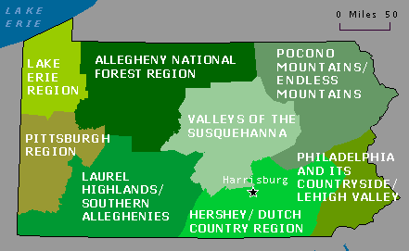
1. Hershey/Dutch Region 2. Laurel Highland Region 3. Valleys of the Susquehanna 4. Pittsburg Region 5. Pocono Mountains Region 6. Allegheny National Forest 7. Philadelphia Countryside 8. Lake Erie Region
Matching Tourist Activities with Vacation Regions

Slide 19
Matching
1. Hershey/Dutch Region 2. Laurel Highland Region 3. Valleys of the Susquehanna 4. Pittsburg Region 5. Pocono Mountains Region 6. Allegheny National Forest 7. Philadelphia Countryside 8. Lake Erie Region
Tour the winter camp of Valley Forge -7
Picnic among the rolling hills of Moraine State Park -4
Canoe or swim at the Delaware Water Gap -5
Observe Little League World Series in Williamsport -3
Visit the world’s largest chocolate factory -1
Walk on the deck of the U.S.S. Niagara on Lake Erie -8
Observe where and how the world’s first oil well was drilled -6
See what it was like to live the Johnstown Flood of 1889 -2

Slide 20
9. Resources and Economy

Slide 21
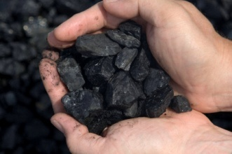
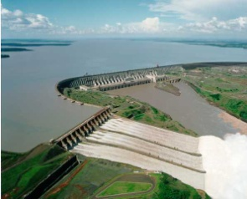
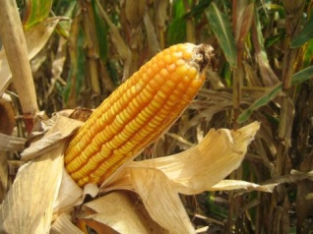
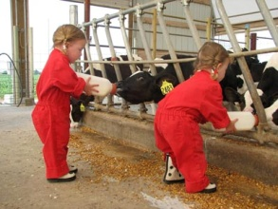
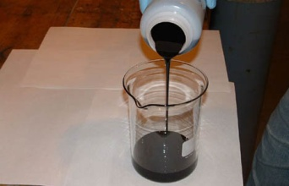
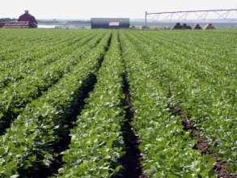
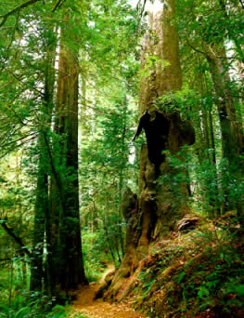
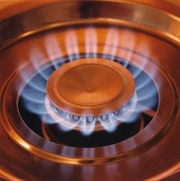
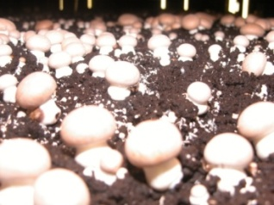
Coal
Oil
Natural Gas
Water
Soil
Forests
Corn
Diary
Mush-room

Slide 22
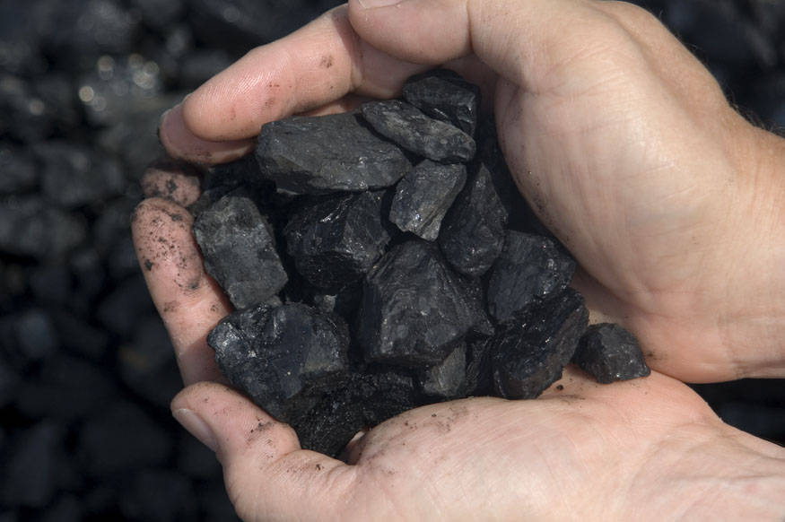
Coal

Slide 23
Oil – Gas for Car

Slide 24
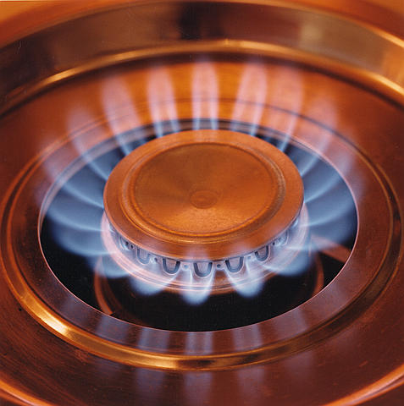
Natural Gas – For Cooking

Slide 25
Water – Hydropower Plant

Slide 26
Soil - Farming

Slide 27
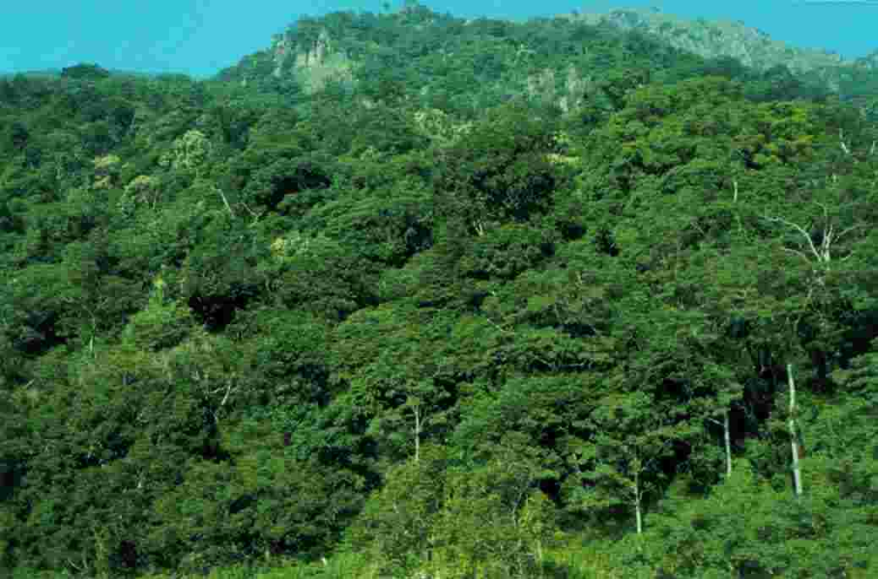
Forests – Lumber and Paper

Slide 28
Corn -Food

Slide 29
Dairy -- Chocolate

Slide 30
Mushroom - Food

Slide 31
10. PA Geographic Features

Slide 32
PA Geographical Features Plateaus and Plains Mountains and Valleys Forestry and Lakes Rivers and Bridges Reservoirs and Dams

Slide 33
End

